Slide 1

Introduction to Artificial Intelligence
Alpha-Beta-Pruning Minmax Search in Checkers Game
Presented by:
Stephen Nwagwughiagwu
Sayli Ambure
Rhoda Ajayi

Slide 2
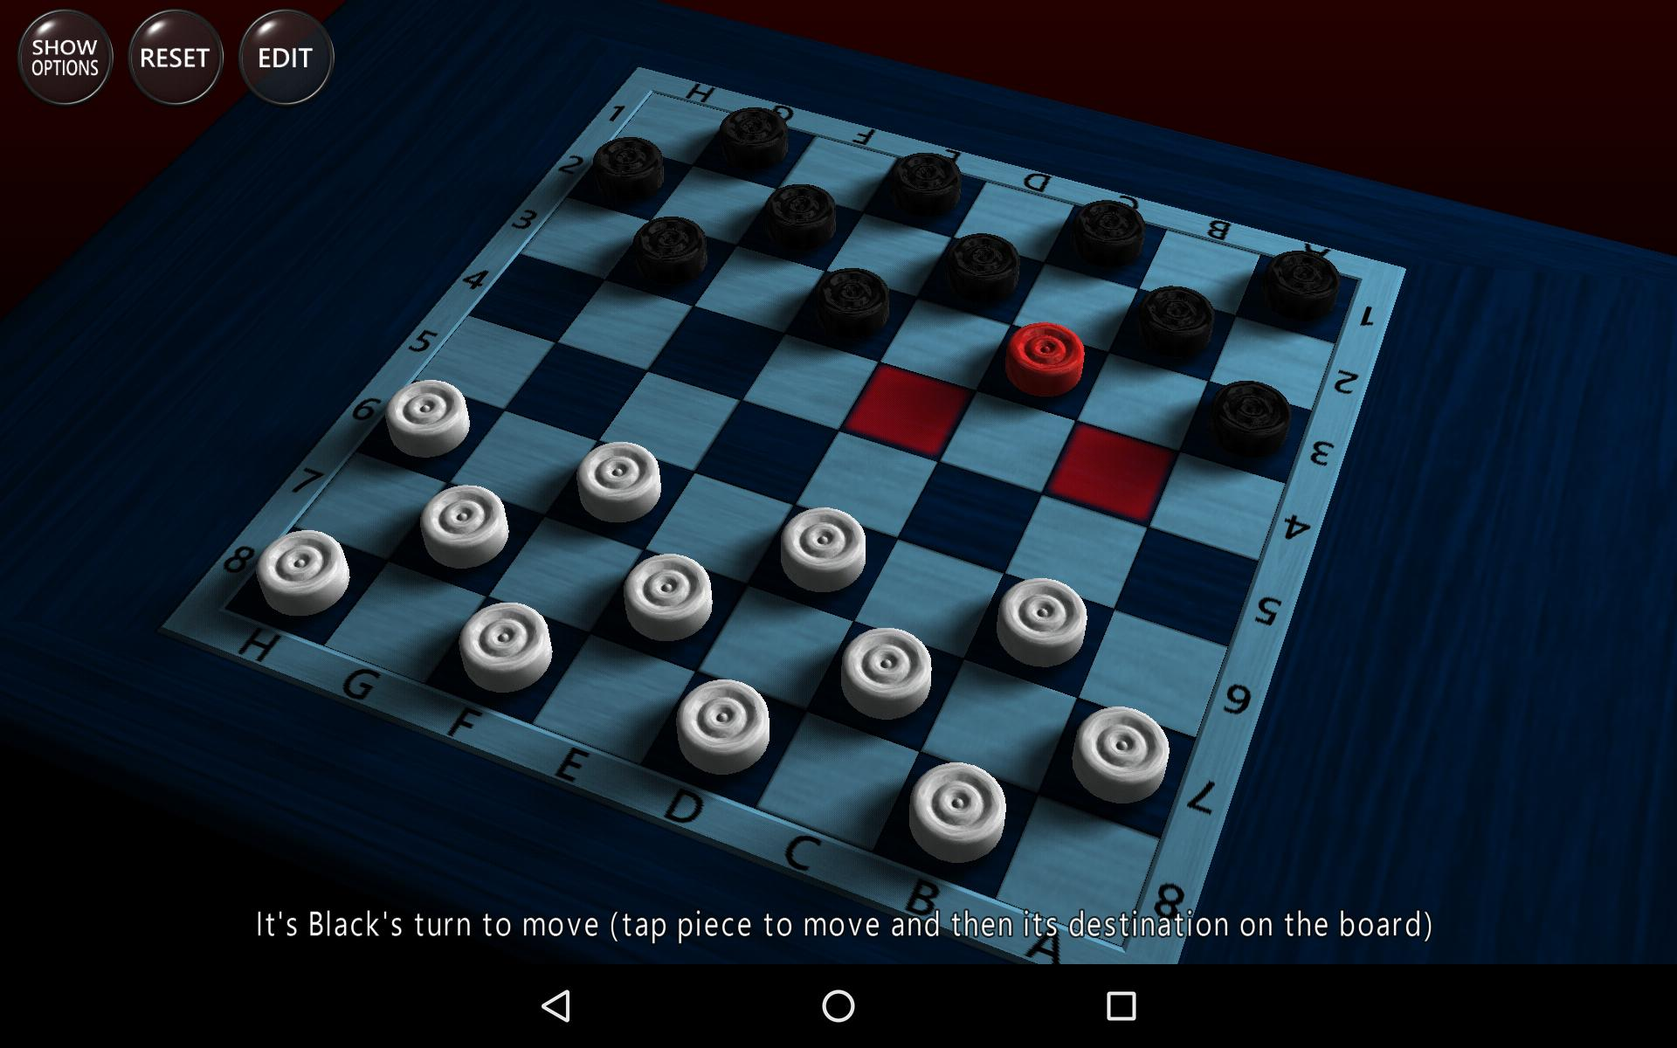




Checkers Game Overview
Application of Alpha-Beta-Pruning Minmax Search in the Checkers Game
Demo/Evaluation & Analysis
Conclusion
2

Slide 3
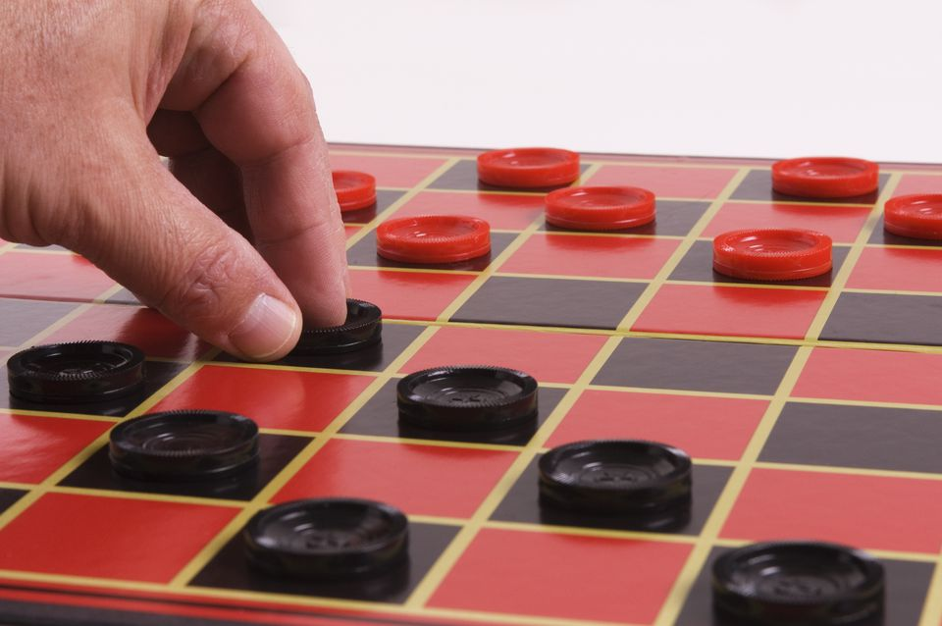

Checkers Game Overview
Pieces can only move diagonally on the dark squares.
A player cannot move onto a square that is occupied by another piece
If an opponent piece is on the square diagonally in front of you and the square behind it is empty then you can (and must!) jump over it diagonally, thereby capturing it.
If a piece reaches the end row of the board, on the opponent's side, it becomes a King. Kings can move diagonally forwards and backwards, making them more powerful in jumping over opponent pieces.

Slide 4
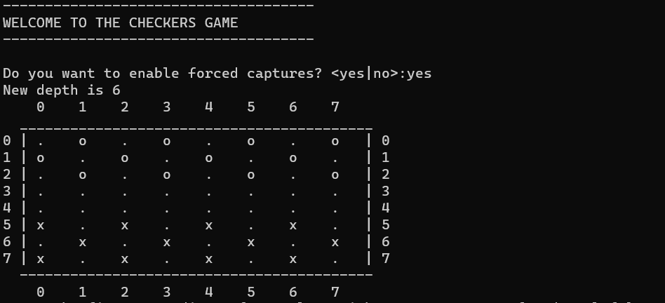



Build of the Checkers Game: How to Play
Human Player has piece “x” and AI Agent has piece “o”
The objective of the game is to beat the opponent or win the game by eating all the opponent's pieces or making the opponent unable to make a move.
How to Play
Human Player chooses the coordinate (x,y) of the piece to move
AI Agent takes turn and computes its own next move and moves its own piece
Human Player chooses the coordinate (x,y) of the free/available square predicted by the AI agent (Minmax Algorithm with Alpha-beta pruning.
(𝛼−𝛽) pruning is employed and time for AI’s decision-making is calculated. Human Player has turn to play again.

Slide 5
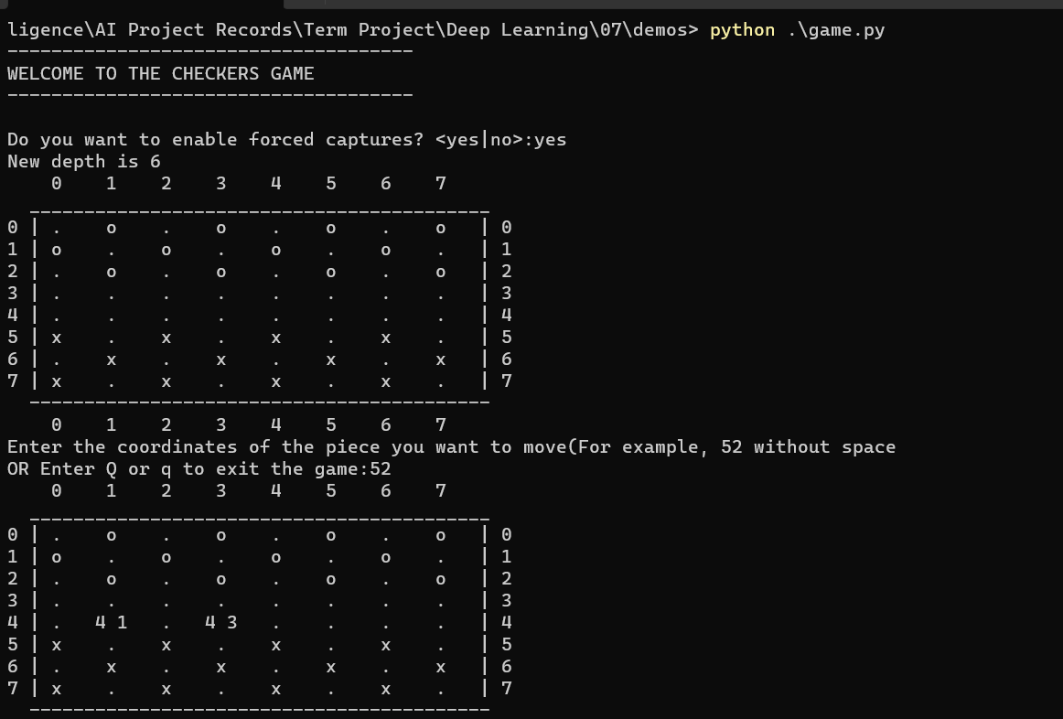
Interface and Implementation Design
The Command Line Interface (CLI) design is loaded when the user runs the command: python game.py. This consists of a 8x8 checkers board with 12 pieces on each side. Pieces “x” for the human player and “o” for AI agent. The game consists of 4 modules:
game.py: This module will be the main class that will manage the game.
input.py: Contains helper functions that take input from human player on choice of piece to move.
output.py: Responsible to printing the state of the board after each turn of the respective players
position.py: Contains the position class which captures the state of the Human player & AI Agent pieces on the checker’s board.

Slide 6
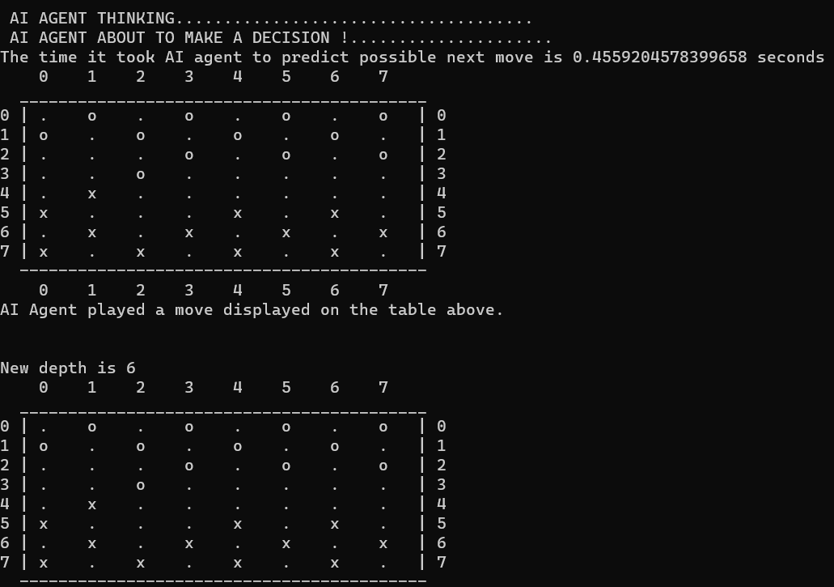
Build of the Checkers Game

Slide 7
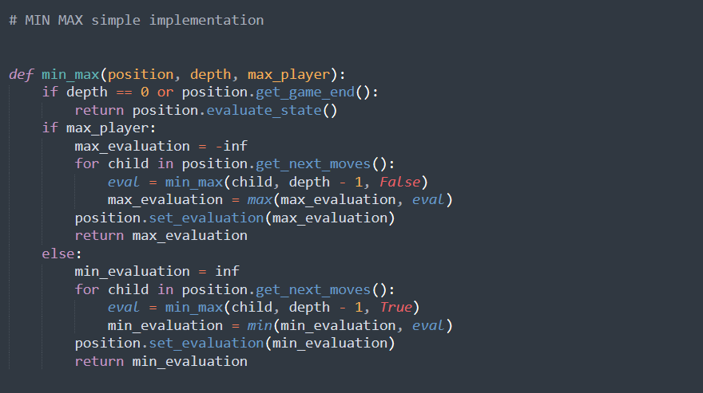
Evaluation Function (Minmax Algorithm)
The Evaluation function is used in the checkers Game to evaluate the “goodness” of the checkers game position.
Contrast with heuristic search where the evaluation function was a non-negative estimate of the cost from the start node to a goal and passing through the given node.
The zero-sum assumption allows us to use a single evaluation function to describe the goodness of a board with respect to both players (Human player & AI Agent)
f(n) >> 0: position n good for me and bad for AI Agent
f(n) << 0: position n bad for me and good for AI agent
f(n) near 0: position n is a neutral position
f(n) = +infinity: win for me
f(n) = -infinity: win for AI Agent

Slide 8
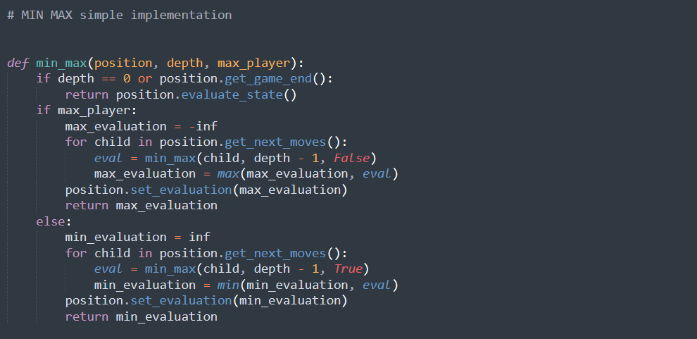
Implementation of the Minmax Algorithm in Checkers

Slide 9
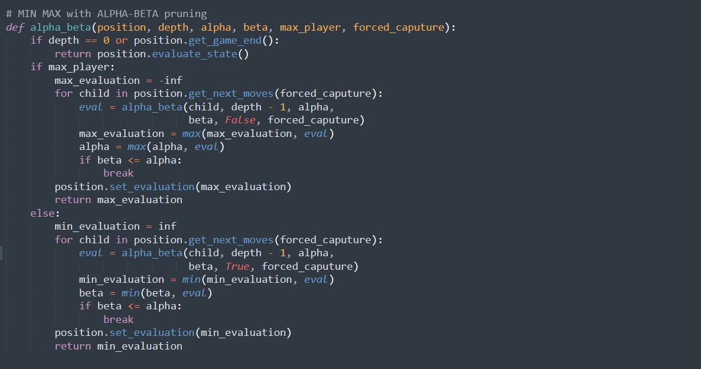
The Logic of the Alpha-Beta Pruning Algorithm

Slide 10
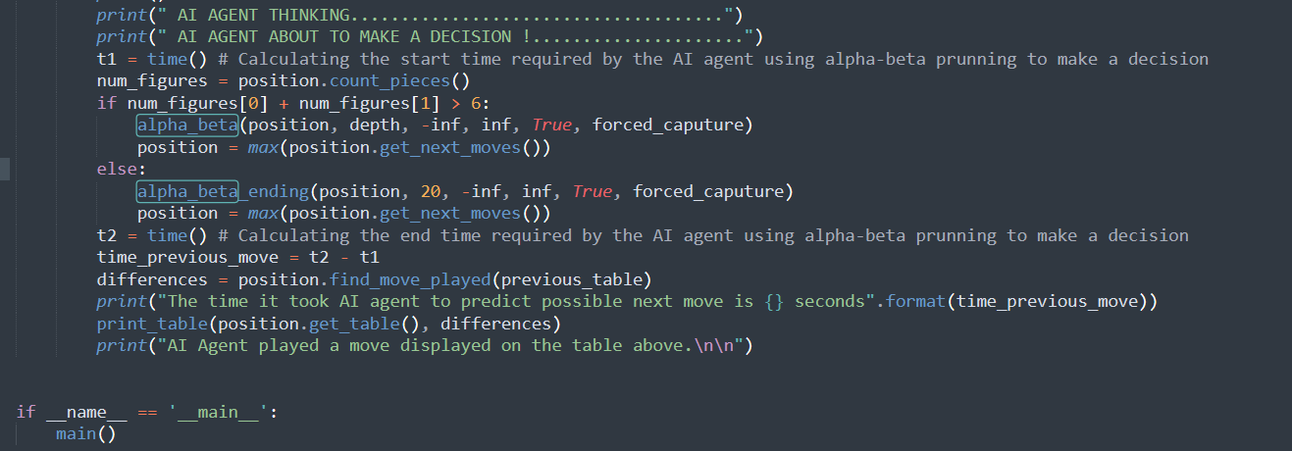
AI Agent’s Decision-Making Time calculation Algorithm

Slide 11
Demo

Slide 12
Evaluation & Analysis

Slide 13
Evaluation & Analysis - Conclusion
Based on the results, the Alpha-beta pruning employed in the Checkers game had the following impact:
Efficiency: The algorithm should be able to evaluate a large number of moves in a short amount of time to ensure that the AI agent is making optimal moves efficiently. The efficiency of the algorithm can be measured in terms of the average time taken by the AI agent to make a move and the number of moves it evaluates in a given time.
Accuracy: The algorithm was able to accurately predict the opponent's next move and select the optimal move for the AI agent. The accuracy of the algorithm can be measured in terms of the number of times the AI agent wins or minimizes losses against the opponent.
Complexity of the game: Checkers is a game with a moderate level of complexity, with a relatively low branching. Hence, the Minimax algorithm with Alpha-beta pruning should be able to evaluate all possible moves in a reasonable amount of time.
Size of the search space: The search space in checkers is relatively small compared to other games, but it required evaluating a large number of possible moves. The Alpha-beta pruning technique was used to reduce the size of the search space and improve the efficiency of the algorithm.

Slide 14
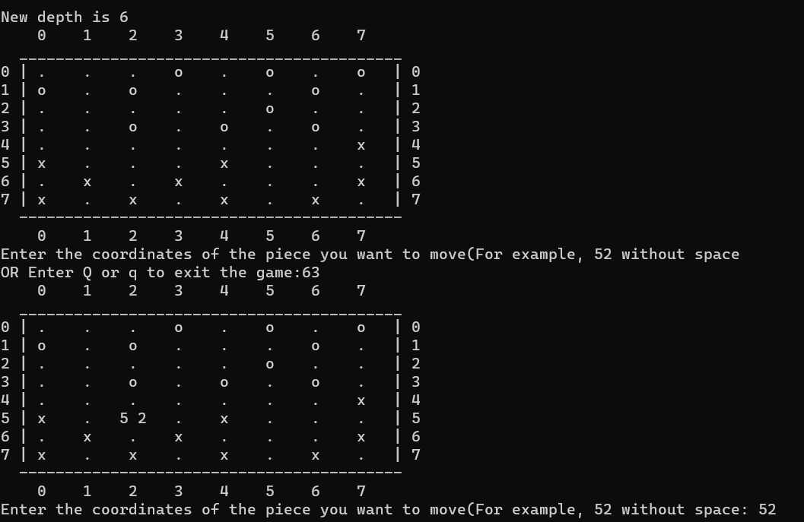
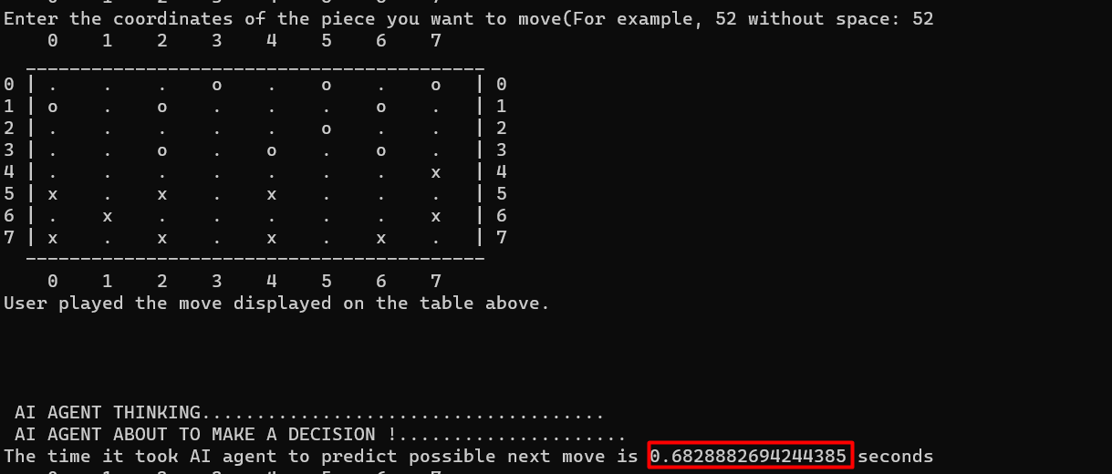
AI Agent’s Decision-Making Time calculation Algorithm

Slide 15
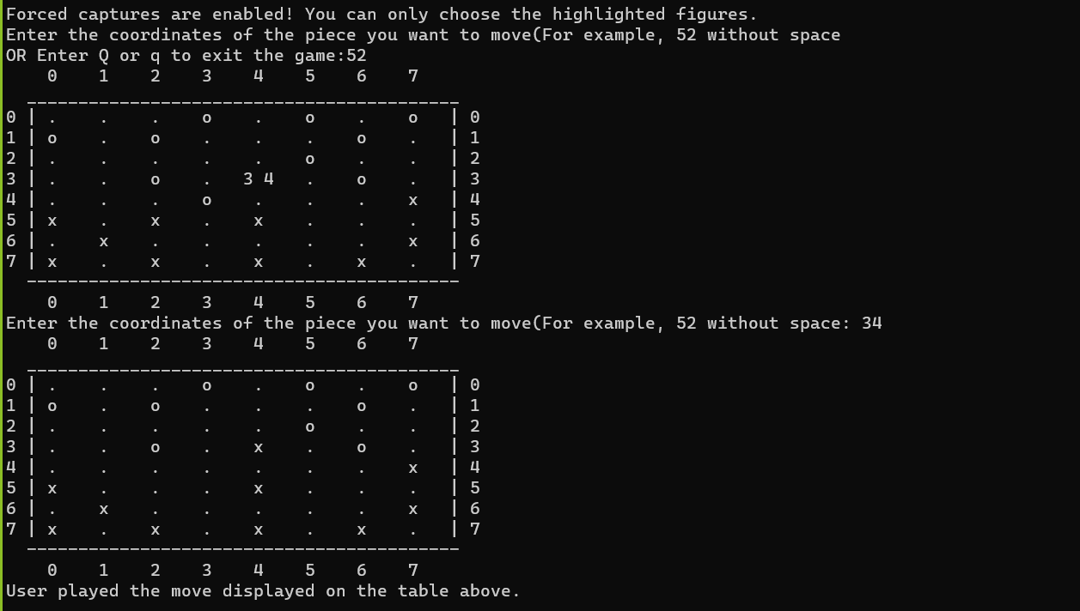
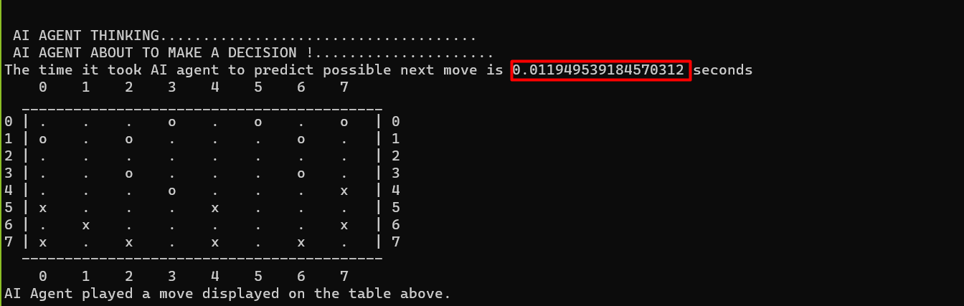
AI Agent’s Decision-Making Time calculation Algorithm

Slide 16
References
[1] https://www.javatpoint.com/ai-alpha-beta-pruning
[2] https://www.cs.cornell.edu/courses/cs312/2002sp/lectures/rec21.htm
[3] https://people.cs.pitt.edu/~litman/courses/cs2710/lectures/pruningReview.pdf
[4] https://www.codingninjas.com/codestudio/library/the-alpha-beta-pruning-algorithm
[5] https://en.wikipedia.org/wiki/Minimax
[6] Step-by-step Alpha Beta Pruning: https://www.youtube.com/watch?v=xBXHtz4Gbdo
[7] https://medium.com/edureka/alpha-beta-pruning-in-ai-b47ee5500f9a
[8] Alpha Beta Practice: https://pascscha.ch/info2/abTreePractice/

Slide 17
Thank You for Listening

